Slide 1
CSE 3141 Real-time system design
Lecturer: Dr. Ronald Pose
No prescribed textbook
Course material defined by lectures and material contained here or distributed at lectures. The examination will only contain material covered in lectures. This subject differs considerably from that given in 2000.
Material presented here is derived from
Real-Time Systems by Jane W.S. Liu.
This book does not cover all the material for this subject and we will not cover a great deal of this detailed book.
Some assignments or lab exercises will be scheduled late in the semester.

Slide 2
Real-time system design
Outline of topics

Slide 3
Typical real-time applications
Digital control
  Sampled data systems
High-level controls
  Planning and policy above low level control
Signal processing
  Digital filtering, video compression & encryption, radar signal processing
Other real-time applications
  Real-time databases, multimedia applications

Slide 4
Hard versus soft real-time system
Jobs and Processors
Release Times, Deadlines, and Timing Constraints
Hard and Soft Timing Constraints
Hard Real-Time Systems
Soft Real-Time Systems

Slide 5
A Model of Real-Time Systems
Processors and Resources
Timing Parameters of Real-Time Workload
Periodic Task Model
Precedence Constraints and Data Dependency
Other Types of Dependencies
Resource Parameters
Scheduling Hierarchy

Slide 6
Approaches to Real-Time Scheduling
Clock-Driven Approach
Weighted Round-Robin Approach
Priority-Driven Approach
Dynamic versus Static Systems
Effective Release Times and Deadlines
Earliest Deadline First (EDF) Algorithm
Least Slack Time First (LST) Algorithm
Validation of Schedules

Slide 7
Clock-Driven Scheduling
Static, Timer-Driven Scheduler
Cyclic Schedules
Aperiodic Jobs
Scheduling Sporadic Jobs
Algorithms to Construct Static Schedules
Advantages / Disadvantages of Clock-Driven Scheduling

Slide 8
Priority-Driven Scheduling of Periodic Tasks
Fixed versus Dynamic Priority Algorithms
Maximum Schedulable Utilization
Rate Monotonic Algorithms
Deadline Monotonic Algorithms
Schedulability Tests

Slide 9
Scheduling Aperiodic and Sporadic Jobs in Priority-Driven Systems
Deferable Servers
Sporadic Servers
Constant Utilization, Total Bandwidth, and Weighted Fair-Queueing Servers
Slack Stealing in Deadline-Driven Systems
Slack Stealing in Fixed-Priority Systems
Scheduling of Sporadic Jobs
A Two-Level Scheduling Scheme

Slide 10
Resources and Resource Access Control
Effects of Resource Contention and Resource Access Control
Non-preemptive Critical Sections
Priority-Inheritance Protocol
Priority-Ceiling Protocol
Preeemption-Ceiling Protocol
Controlling Access to Multiple Resources Controlling Concurrent Access

Slide 11
Multiprocessor Scheduling, Resource Access Control, and Synchronization
Multiprocessors and Distributed Systems
Task Assignment
Multiprocessor Priority-Ceiling Protocol
Scheduling for End-to-End Periodic Tasks
Schedulability of Fixed-Priority End-to-End Periodic Tasks
End-to-End Tasks in Heterogeneous Systems and Dynamic Multiprocessors

Slide 12
Real-Time Communication
Model of Real-Time Communication
Priority-Based Service for Switched Networks
Weighted Round-Robin Service
Medium Access-Control Protocols of Broadcast Networks
Internet and Resource Reservation Protocols
Real-Time Protocol

Slide 13
Operating Systems
Time Services and Scheduling Mechanisms
Other Basic Operating System Functions
Resource Management
Commercial Real-Time Operating Systems
Predictability of General-Purpose Operating Systems

Slide 14
What goes on in a Real-Time Operating System
Real-Time Operating System Kernel Design
Should I use a Real-Time Kernel?
Should I build my own?
Should I distribute the system?
Can I have access to the underlying hardware or must I make to with an existing operating system?
How can I deal with a shared system?

Slide 15
The Overall Real-Time System
Mixing Real-Time and Other Jobs
Approaches to Real-Time System Design
Specifying Required Performance
Testing and Validating the System
What to do if Specifications are not met or cannot be met

Slide 16
Summary
Summarize and revise the important topics
Look at Sample Examination Questions
Examine the Laboratory Assignments to see how they fit into the framework discussed in lectures

Slide 17
Digital Control Applications
Many real-time systems are embedded in sensors and actuators and function as digital controllers.
The state of the controlled system is monitored by sensors and can be changed by actuators.
The real-time computing system estimates from the sensor readings the current state of the system and computes a control output based on the difference between the current state and the desired state.
The computed output controls the actuators which bring the system closer to the desired state.

Slide 18
Sampled Data Systems
Before digital computers were widely used, analogue controllers were used to control systems.
A common approach to designing a digital controller is to start with a suitable analogue controller.
The analogue version is transformed into a digital (discrete time, discrete state) version.
The resultant controller is a sampled data system.

Slide 19
Inside a Sampled Data System
Periodically the analogue sensors are sampled (read) and the readings digitized.
Each period the control-law computations are carried out on the digitized readings.
The computed digital results are then converted back to an analogue form needed for the actuators.
This sequence of operations is repeated periodically.

Slide 20
Computing the Control Law for a Sampled Data System
Many control systems require knowledge of not just the current sensor readings, but also some past history.
For instance it may be necessary to know not only the position of some part of the controlled system, but also its velocity and perhaps its acceleration.
Often the control laws may take the form of differential equations. It may be necessary to have derivatives or integrals of measured readings.

Slide 21
Integrating and Differentiating the Digitized Sensor Inputs
In order to compute an approximation to the derivative of the sensor input it is necessary to keep a series of past readings. It may also be necessary to keep a series of past derivative values so as to approximate the 2nd derivative.
For instance if one knows the time between samples, one can calculate from the difference between successive sampled positions, an instantaneous velocity, and from the difference between successive velocities, an acceleration.

Slide 22
Integration
Just as we can approximate the derivatives of various sampled values, so we can also approximate integrals.
To do this we can use various numerical integration algorithms such as a simple trapezoidal method.
So given a starting position and some past and current acceleration and velocities we can approximate the current position.

Slide 23
A Feedback Control Loop
set timer to interrupt periodically with period T;
at each timer interrupt do
  do analogue-to-digital conversion
  compute control output
  do digital-to-analogue conversion
end do
We have assumed that the system provides a timer.

Slide 24
Selection of Sampling Period
The length T of time between any two consecutive instants at which the inputs are sampled is called the sampling period.
T is a key design choice.
The behaviour of the digital controller critically depends on this parameter.
Ideally we want the sampled data version to behave like the analogue controller version.
This can be done by making T very small.
However this increases the computation required.
We need a good compromise.

Slide 25
Choosing the Sampling Period
We need to consider two factors:
  The perceived responsiveness of the overall system
    Sampling introduces a delay in the system response.
    A human operator may feel that the system is ‘sluggish’ if the delay in response to his input is greater than about a tenth of a second.
    Thus manual systems must normally be sampled at a rate higher than ten times per second.
  The dynamic behaviour of the system
    If the sampling rate is too low, the control loop may not be able to keep the oscillation in its response small enough.

Slide 26
Selecting sampling rate to ensure dynamic behaviour of the system
In general, the faster a system can and must respond to changes, the shorter the sampling period should be.
We can measure the responsiveness of the system by its rise time R.
R is the time it takes to get close to its final state after the input changes.
Typically you would like the ratio R/T of rise time to sampling period to be between 10 and 20.

Slide 27
Sampling rate
A shorter sampling period is likely to reduce the oscillation in the system at the cost of more computation.
One can also consider this in terms of bandwidth ω which is approximately 1/2R Hz. So the sampling rate should be 20 to 40 times the bandwidth ω.
The Nyquist sampling theorem says that any time-continuous signal of bandwidth ω can be reproduced faithfully from its sampled values only if the sampling rate is at least 2 ω.
Note that the recommended sampling rate for simple controllers is much higher than this minimum.

Slide 28
Multirate systems
A system typically has state defined by multiple state variables. e.g. rotation speed, temperature, fuel consumption, etc. of an engine.
The state is monitored by multiple sensors and controlled by multiple actuators.
Different state variables have different dynamics and will require different sampling periods to achieve smooth response. e.g. the rotation speed will change faster than its temperature.
A system with multiple sampling rates is called a multirate system.

Slide 29
Sampling in multirate systems
In multirate systems it is often useful to have the sampling rates related in a harmonic way so that longer sampling periods are integer multiples of shorter ones.
This is useful because the state variables are usually not independent, and the relationships between them can be modelled better if longer sampling periods coincide with the beginning of the shorter ones.

Slide 30
Timing characteristics
The workload generated by each multivariate, multirate digital controller consists of a few periodic control-law computations.
A control system may contain many digital controllers, each dealing with part of the system.
Together they demand perhaps hundreds of control-laws be computer periodically, some continuously, others in reaction to some events.
The control laws of each multirate controller may have harmonic periods and typically use the date produced by each other as inputs, and are said to be a rate group.

Slide 31
Control law computation timing
Each control-law computation can begin shortly after sampling.
Usually you want the computation complete, hence the sensor data processed, before the next sensor data sampling period.
This objective is met when the response time of each computation never exceeds the sampling period.

Slide 32
Jitter
In some cases the response time of the computation can vary from period to period.
In some systems it is necessary to keep this variation small so that digital control outputs are available at instants more regularly spaced in time.
In such cases we may impose a timing jitter requirement on the control-law computation. The variation in response time (jitter) does not exceed some threshold.

Slide 33
More complex control-law computations
The simplicity of our digital controller depends on three assumptions:
1 Sensors give accurate estimates of the state-variable values being monitored and controlled. This is not always true given noise or other factors.
2 Sensor data give the state of the system. In general sensors monitor some observable attributes and the values of state variables have to be computed from the measured values.
3 All parameters representing the dynamics of the system are known.

Slide 34
A more complex digital controller
set timer to interrupt peiodically with period T;
At each clock interrupt do
  Sample and digitize sensor readings;
  Compute control output from measured and state-variable values;
  Convert control output to analogue form;
  Estimate and update system parameters;
  Compute and update state variables;
End do;
The last 2 steps in the loop increase processing time.

Slide 35
High-Level Controls
Controllers in complex systems are typically organized hierarchically.
One or more digital controllers at the lowest level directly control the physical system.
Each output of a higher-level controller is an input of one or more lower-level controllers.
Usually one or more of the higher-level controllers interfaces with the operator.

Slide 36
Examples of control hierarchy
A patient care system in a hospital.
  Low-level controllers handling blood pressure, respiration, glucose, etc.
  High-level controller, e.g. an expert system which interacts with the doctor to choose desired values for the low-level controllers to maintain.
The hierarchy of flight control, avionics and air-traffic control systems.
  The air-traffic control system is at the highest level.
  The flight management system chooses the flight paths etc. and sets parameters for the lower level controllers.
  The flight controller at the lowest level handles cruise speed, turn radius, ascend/descend rates etc.

Slide 37
Signal Processing
Most signal processing applications are real-time requiring response times from less than a millisecond up to seconds. e.g. digital filtering, video and audio compression/decompression, and radar signal processing.
Typically a real-time signal processing application computes in one sampling period, one or more outputs, each being a weighted sum of n inputs. The weights may even vary over time.

Slide 38
Signal Processing Bandwidth Demands
The processing time demand of an application depends on the sampling period and how many outputs are required to be produced per sampling period.
For digital filtering the sampling rate can be tens of kHz and the calculation may involve tens or hundreds of terms, hence tens of millions of multiplications and additions may be required per second.

Slide 39
More complex signal processing
While digital filtering is often a linear computation depending on the number of terms in the expression, other signal processing applications are even more computationally intensive.
For instance real-time video compression may have complexity of order n², and may require hundreds of millions of multiplications per second.

Slide 40
Radar signal processing
Signal processing is usually part of a larger system. e.g. a passive radar signal processing system.
The system comprises an I/O subsystem that samples and digitizes the echo signal from the radar and places the sampled values in shared memory. An array of digital signal processors process these values. The data produced are analyzed by one or more data processors which not only interface to the display system but also feed back commands to control the radar and select parameters for the signal processors to be used for the next sampling period.

Slide 41
Real-time databases
Stock exchange price database systems
Air traffic control databases
What makes it real-time?
  The data is ‘perishable’
  The data values are updated periodically
  After a while the data has reduced value
  There needs to be temporal consistency as well as normal data consistency

Slide 42
Absolute Temporal Consistency
Real-time data has parameters such as age and temporal dispersion.
The age of an object measures how up-to-date the information is.
The age of an object whose value is computed from other objects is equal to that of the oldest of those objects.
A set of data objects is said to be absolutely temporally consistent if the maximum age in the set is no greater than a certain threshold.

Slide 43
Relative temporal consistency
A set of data objects is said to be relatively temporally consistent if the maximum difference in the ages is less than the relative consistency threshold used by the application.
For some applications the absolute age is less important than the differences in ages.

Slide 44
Real-time database consistency models
Concurrency control mechanisms such as 2-phase locking have been used to ensure serializability of read and update transactions and maintain data integrity of non-real-time databases.
These mechanisms can make it more difficult for updates to be completed in time.
Late updates may cause data to become temporally inconsistent.
Weaker consistency models are sometimes used to ensure the timeliness of updates and reads.

Slide 45
Consistency Models
For instance we may require updates to be serializable but allow read-only transactions not to be serializable.
Usually the more relaxed the serialization requirement, the more flexibility the system has in interleaving the read and write operations from different transactions, and the easier it is to schedule transactions so that they complete in time.

Slide 46
Correctness of real-time data
Kuo and Mok proposed that ‘similarity’ may be a suitable correctness criterion in some real-time situations.
Two views of a transaction are ‘similar’ if every read operation gets similar values of every data objects read by the transaction, where ‘similar’ means that the data values are within an acceptable threshold from the point of view of every transaction that may read the object.

Slide 47
Summary of real-time applications
1. Purely cyclic: Every task executes periodically. Even I/O operations are polled. Demands on resources do not vary significantly from period to period. Most digital controllers are of this type.
2. Mostly cyclic: Most tasks execute periodically. The system can also respond to some external events asynchronously.
3. Asynchronous and somewhat predictable: In applications such as multimedia communication, radar signal processing, tracking, most tasks are not periodic. Duration between executions of a task may vary considerably or the resource requirements may vary. Variations have bounded ranges or known statistics.
4. Asynchronous and unpredictable.

Slide 48
Reference Model of Real-Time Systems
We need a reference model of real-time systems to allow us to focus on aspects of the system relevant to its real-time timing and resource properties.
There are many possible models of real-time systems.
We will examine an example but it is not meant to be definitive.

Slide 49
Elements of the reference model
Each system is characterized by 3 elements:
  A workload model describing the applications supported by the system
  A resource model describing the system resources available to the applications
  Algorithms that define how the application system uses the resources at all times.

Slide 50
Use of a reference model
If we choose to do so we can describe a system sufficiently accurately in terms of the reference model, that we can analyze, simulate, and even emulate a system based on its description.
For some real-time systems we know in advance the resources and applications we want to run.
In other systems resources and tasks may be added dynamically.

Slide 51
Algorithmic part of the reference model
First we will look briefly at the description of resources and applications, the first two parts of the reference model.
Then we will spend much of the rest of the time looking at algorithms and methods to enable us to produce systems which have the desired real-time characteristics.

Slide 52
Processors and Resources
We divide all the system resources into two types:
  processors (sometimes called servers or active resources such as computers, data links, database servers etc.)
  other passive resources (such as memory, sequence numbers, mutual exclusion locks etc.)
Jobs may need some resources in addition to the processor in order to make progress.

Slide 53
Processors
Processors carry out machine instructions, move data, retrieve files, process queries etc.
Every job must have one or more processors in order to make progress towards completion.
Sometimes we need to distinguish types of processors.

Slide 54
Types of processors
Two processors are of the same type if they can be used interchangeably and are functionally identical.
  Two data links with the same transmission rates between the same two nodes are considered processors of the same type. Similarly processors in a symmetric multiprocessor system are of the same type.
One of the attributes of a processor is its speed. We will assume that the rate of progress a job makes depends on the speed of the processor on which it is running.

Slide 55
Speed
We can explicitly model the dependency of job progression and processor speed by making the amount of time a job requires to complete a function of the processor speed.
In contrast we do not associate speed with a resource.
How long a job takes to complete does not depend on the speed of any resource it uses during execution.

Slide 56
Example of a job (1)
A computation job may share data with others computations, and the data may be guarded by semaphores. Each semaphore is a resource. When a job wants to access the shared data guarded by a semaphore R, it must first lock the semaphore, then it enters the critical section of code. In this case we say that the job requires the resource R for the duration of this critical section.

Slide 57
Example of a job (2)
Consider a data link that uses a sliding-window scheme for flow control. Only a maximum number of messages are allowed to be in transit. One way to implement this is to have the sender maintain a window of valid sequence numbers. The window is moved forward as messages transmitted earlier are acknowledged by the receiver. A message awaiting transmission must be allocated one of the valid sequence numbers before transmission.
We model the transmission of the message as a job which executes as the message is being transmitted. This job needs the data link as well as a valid sequence number. The data link is a processor and a sequence number is a resource.

Slide 58
Examples of jobs (3)
We usually model query and update transactions to databases as jobs. These jobs execute on a database server. If the database server uses a locking mechanism to ensure data consistency then a transaction also needs locks on the data objects it reads/writes in order to proceed.
The locks on data objects are resources.
The database server is a processor.

Slide 59
Resources
Resources in the examples were reusable since they were not consumed during use.
Other resources are consumed during use and cannot be used again.
Some resources are serially reusable. There may be many units of a serial resource, but each can only be used by one job at a time,
To prevent our model being cluttered by irrelevant details we typically omit resources which are plentiful.
  A resource is plentiful if no job is ever prevented from running by the lack of this resource.

Slide 60
Infinite resources
A resource that can be shared by an infinite number of jobs need not be explicitly modelled. (e.g. a file that is readable simultaneously by everyone)
Memory is clearly an essential resource, however if we can account for the speed of the memory by the speed of the processor-memory combination, and if memory is not a bottleneck, we can omit it from the model.

Slide 61
Memory
For example, we can account for the speed of buffer memory in a communications switch by letting the speed of each link equal the transmission rate of the link or the rate at which data can get into or out of the buffer, whichever is smaller.

Slide 62
Processor or Resource?
We sometimes model some elements of the system as processors and sometimes as resources, depending on how we use the model.
For example, in a distributed system a computation job may invoke a server on a remote processor.
  If we want to look at how the response time of this job is affected by the way the job is scheduled on its local processor, we can model the remote server as a resource.
  We may also model the remote server as a processor.

Slide 63
Modelling choices
There are no fixed rules to guide us in deciding whether to model something as a processor or as a resource, or to guide us in many other modelling choices.
A good model can give us better insight into the real-time problem we are considering.
A bad model can confuse us and lead to a poor design and implementation.
In many ways this is an art which requires some skill but provides great freedom for designing and implementing real-time systems.

Slide 64
Temporal parameters of real-time workloads
The workload on processors consists of jobs, each of which is a unit of work to be allocated processor time and other resources.
A set of related jobs which combine to support a system function is a task.
We assume that many parameters of hard real-time jobs and tasks are known at all times; otherwise we could not ensure that the system meets its real-time requirements.

Slide 65
Real-time workload parameters
The number of tasks or jobs in the system.
  In many embedded systems the number of tasks is fixed for each operational mode, and these numbers are known in advance.
  In some other systems the number of tasks may change as the system executes.
  Nevertheless, the number of tasks with hard timing constraints is known at all times.
  When the satisfaction of timing constraints is to be guaranteed, the admission and deletion of hard real-time tasks is usually done under the control of the run-time system.

Slide 66
The run-time system
The run-time system must maintain information on all existing hard real-time tasks, including the number of such tasks, and all their real-time constraints and resource requirements.

Slide 67
The job
Each job J_{i} is characterized by its temporal parameters.
Its temporal parameters tell us its timing constraints and behaviour.
Its interconnection parameters tell us how it depends on other jobs and how other jobs depend on it.
Its functional parameters specify the intrinsic properties of the job.

Slide 68
Job temporal parameters
For job J_{i}
  Release time r_{i}
  Absolute deadline d_{i}
  Relative deadline D_{i}
  Feasible interval (r_{i}, d_{i}]
d_{i} and D_{i} are usually derived from the timing requirements of J_{i}, other jobs in the same task as J_{i}, and the overall system.
These parameters are part of the system specification.

Slide 69
Release time
In many systems we do not know exactly when each job will be released.
i.e. we do not know r_{i}
We know that r_{i} is in the range [r_{i}⁻, r_{i}⁺]
  R_{i} can be as early as r_{i}⁻ and as late as r_{i}⁺
  Some models assume that only the range of r_{i} is known and call this range, release time jitter.
  If the release time jitter is very small compared with other temporal parameters, we can approximate the actual release time by its earliest r_{i}⁻ or latest r_{i}⁺ release time, and say that the job has a fixed release time.

Slide 70
Sporadic jobs
Most real-time systems have to respond to external events which occur randomly.
When such an event occurs the system executes a set of jobs in response.
The release times of those jobs are not known until the event triggering them occurs.
These jobs are called sporadic jobs or aperiodic jobs because they are released at random times.

Slide 71
Sporadic job release times
The release times of sporadic and aperiodic jobs are random variables.
The system model gives the probability distribution A(x) of the release time of such a job.
When there is a stream of similar sporadic or aperiodic jobs the model provides a probability distribution of interrelease time, i.e. how long between the release times of two consecutive jobs in the stream.
A(x) gives us the probability that the release time of a job is at or earlier than x, or in the case of interrelease time, that it is less than or equal to x.

Slide 72
Arrival times
Rather than speaking of release times for aperiodic jobs, we sometimes use the term arrival time (or interarrival time) which is commonly used in queueing theory.
An aperiodic job arrives when it is released.
A(x) is the arrival time distribution or interarrival time distribution.

Slide 73
Execution time
Another temporal parameter of a job J_{i} is its execution time, e_{i}.
e_{i} is the time required to complete the execution of J_{i} when it executes alone and has all the resources it requires.
The value of e_{i} depends mainly on the complexity of the job and the speed of the processor used to execute the job.
e_{i} does not depend on how the job is scheduled.

Slide 74
Job execution time
The execution time of a job may vary for many reasons.
  A computation may contain conditional branches and these conditional branches may take different amounts of time to complete.
  The branches taken during the execution of a job depend on input data.
  If the underlying system has performance enhancing features such as caches and pipelines, the execution time can vary each time a job executes, even without conditional branches.
Thus the actual execution time of a computational job may be unknown until it completes.

Slide 75
Characterizing executionn time
What can be determined through analysis and measurement are the maximum and minimum amounts of time required to complete each job.
We know that the execution time e_{i} of job J_{i} is in the range [e_{i}⁻, e_{i}⁺] where e_{i}⁻ is the minimum execution time and e_{i}⁺ is the maximum execution time of job J_{i}.
We assume that we know e_{i}⁻ and e_{i}⁺ of every hard real-time job J_{i}, even if we don’t know e_{i}.

Slide 76
Maximum execution time
For the purpose of determining whether each job can always complete by its deadline, it suffices to know its maximum execution time.
In most deterministic models used to characterize hard real-time applications, the term execution time e_{i} of each job J_{i} specifically means its maximum execution time.
However we don’t mean that the actual execution time is fixed and known, only that it never exceeds our e_{i} (which may actually be e_{i}⁺)

Slide 77
Consequences of temporal assumptions
If we design our system based on the assumption that e_{i} is e_{i}⁺ and allocate this much time to each job, the processors will be underutilized.
This is sometimes true.
In some applications the variations in job execution times are so large that working with their maximum values yields unacceptably conservative designs.
We should not model such applications deterministically.

Slide 78
Dangers of deterministic modelling
In some systems the response times of some jobs may be larger when the actual execution times of some jobs are smaller than their maximum values.
In these cases we shall have to deal with variations in execution times explicitly.

Slide 79
Using deterministic modelling
Many hard real-time systems are safety critical.
These systems are designed and implemented in such a way that the variations in job execution times are kept as small as possible.
The need to have relatively deterministic execution times imposes many implementation restrictions.
  Use of dynamic data structures can lead to variable execution time and memory usage.
  Performance enhancing features may be switched off.

Slide 80
Why use the deterministic modelling approach?
By working within these restrictions and making the execution times of jobs almost deterministic, the designer can model more accurately the application system deterministically.
Another reason to stick with the deterministic approach is that the hard real-time portion of the system is often small.
The timing requirements of the rest of the system are soft, so it may be reasonable to assume worst case maximum values for the hard real-time parts of the system since the overall effect on resources won’t be so dramatic.
We can then use the methods and tools of the deterministic modelling approach to ensure that hard real-time constraints will be met at all times and the design can be validated.

Slide 81
Periodic Task Model
The Periodic Task Model is a deterministic workload model.
The model accurately characterizes many traditional hard real-time applications such as digital control, real-time monitoring, and constant bit-rate voice/video transmission.
Many scheduling algorithms based on this model have good performance and well understood behaviour.

Slide 82
Periods
In the periodic task model each computation or data transmission that is executed repeatedly at regular or almost regular time intervals in order to provide a function of the system on a continuing basis, is modelled as a periodic task.
Each periodic task, T_{i}, is a sequence of jobs.
The period p_{i} of the periodic task T_{i} is the minimum length of all time intervals between release times of consecutive jobs in T_{i}.
Its execution time is the maximum execution time of all the jobs in it.
We will cheat and use e_{i} to represent this periodic task execution time as well as that of all its jobs.
At all times the period and execution times of every periodic task in the system are known.

Slide 83
Notes about periodic tasks
Our definition of periodic tasks differs from the strict one given in many textbooks and papers.
We will allow our periodic tasks to have interrelease times of all its jobs not always equal to its period.
Some literature describes tasks with interrelease times of all its jobs not equal to its period as sporadic tasks.
For our purposes a sporadic task is one whose interrelease times can be arbitrarily small.

Slide 84
Periodic Task Model Accuracy
The accuracy of the periodic task model decreases with increasing jitter in release times and variations in execution times.
Thus a periodic task is an inaccurate model of a variable bit-rate video because of the large variation in execution times of jobs.
A periodic task is also an inaccurate model of the transmission of packets in a real-time connection through a switched network because of its large release-time jitter.

Slide 85
Notation (1)
We call the tasks in the system
T₁, T₂, …, T_{n}
where there are n periodic tasks in the system. n can vary as periodic tasks are added or deleted from the system.
We call the individual jobs in the task T_{i}
J_{i,1}, J_{i,2}, …, J_{i,k}
where there are k jobs in the task T_{i}
If we want to talk about individual jobs but are not concerned about which task they are in, we can call the jobs J₁, J₂, etc.

Slide 86
Notation (2)
The release time r_{i,1} of the first job J_{i,1} in each task T_{i} is called the phase of T_{i}
We use φ_{i} to denote the phase of T_{i}
In general different tasks may have different phases.
Some tasks are in phase, meaning that they have the same phase.

Slide 87
Notation (3)
H denotes the least common multiple of p_{i} for i = 1, 2, … n
A time interval of length H is called a hyperperiod of the periodic tasks.
The maximum number of jobs in each hyperperiod is Σ^{n}_{i=1} H / p_{i}
e.g. the length of a hyperperiod for 3 periodic tasks with periods 3,4 and 10 is 60, and the total number of jobs is 41.

Slide 88
Notation (3)
The ratio u_{i} = e_{i} / p_{i} is called the utilization of the task T_{i}
u_{i} is the fraction of time that a truly periodic task with period p_{i} and execution time e_{i} keeps a processor busy.
u_{i} is an upper bound of utilization for the task modelled by T_{i}
The total utilization U of all tasks in the system is the sum of the u_{i}

Slide 89
Utilization
If the execution times of the three periodic tasks are 1, 1, and 3, and their periods are 3, 4, and 10, then their utilizations are 0.33, 0.25 and 0.3
The total utilization of these tasks is 0.88 thus these tasks can keep a processor busy at most 88 percent of the time.

Slide 90
More notation
A job in T_{i} that is released at time t must complete D_{i} units of time after t
D_{i} is the relative deadline of the task T_{i}
We will often assume that for every task a job is released and becomes ready at the beginning of each period and must complete by the end of the period.
In other words D_{i} = p_{i} for all n
This requirement is consistent with the throughput requirement that the system can keep up with all the work required at all times.

Slide 91
More about deadlines
D_{i} can have an arbitrary value however it must be shorter than pi
Giving a task a short relative deadline is a way to specify that variations in the response time of individual jobs (i.e. jitter in their completion times) of the task must be sufficiently small.
Sometimes each job in a task may not be ready when it is released. For example it may have to wait for its input data to be made available in memory.

Slide 92
More about deadlines (2)
The time between the ready time of each job and the end of the period is shorter than the period.
Sometimes there may be some operation to be performed after a job completes but before the next job is released.
Sometimes a job may be composed of dependent jobs which must be executed in sequence.
A way to enforce such dependencies is to delay the release of a job later in the sequence while advancing the deadline of a job earlier in the sequence.
The relative deadlines may also be shortened.

Slide 93
Aperiodic and Sporadic Tasks
Most real-time jobs are required to respond to external events, and to respond they execute aperiodic or sporadic jobs whose release times are not known in advance.
In the periodic task model the workload generated in response to these unexpected events takes the form of aperiodic and sporadic tasks.
Each aperiodic or sporadic task is a stream of aperiodic or sporadic jobs.
The interarrival times between consecutive jobs in such a task may vary widely.

Slide 94
More about aperiodic and sporadic tasks
The interarrival times of aperiodic and sporadic jobs may be arbitrarily small.
The jobs in each task model the work done by the system in response to events of the same type.
The jobs in each aperiodic task are similar in the sense that they have the same statistical behaviour and the same timing requirement.

Slide 95
Aperiodic tasks
Interarrival times of aperiodic jobs are identically distributed random variables with probability distribution A(x)
Similarly the execution times of jobs in each aperiodic or sporadic task are identically distributed random variables according to probability distribution B(x)
These assumptions mean that the statistical behaviour of the system does not change with time. i.e. the system is stationary.

Slide 96
More about aperiodic tasks
That the system is stationary is usually valid for a time interval of length of order H.
That is the system is stationary during any hyperperiod during which no periodic tasks are added or deleted.
We say a task is aperiodic if the jobs in it have either soft deadlines or no deadlines.
We therefore want to optimize the responsiveness of the system for the aperiodic jobs, but never at the expense of hard real-time tasks whose deadlines must be met at all times.

Slide 97
What is a sporadic task?
Tasks containing jobs that are released at random time instants and have hard deadlines are sporadic tasks.
We treat sporadic tasks as hard real-time tasks.
Our primary concern is to ensure that their deadlines are met.
Minimizing their response times is of secondary importance.

Slide 98
Examples of aperiodic and sporadic tasks
Aperiodic task
  An operator adjusts the sensitivity of a radar system. The radar must continue to operate and in the near future change its sensitivity.
Sporadic task
  An autopilot is required to respond to a pilot’s command to disengage the autopilot and switch to manual control within a specified time.
  Similarly a fault tolerant system may be required to detect a fault and recover from it in time to prevent disaster.

Slide 99
Precedence constraints
Data and control dependencies among jobs may constrain the order in which they can execute
Such jobs are said to have precedence constraints
If jobs can execute in any order, they are said to be independent

Slide 100
Precedence constraint example
In a radar surveillance system the signal processing task is the producer or track records which the tracker task is the consumer.
Each tracker job processes the track records produced by a signal processing job.
The tracker job is precedence constrained.
In general a consumer job has this constraint whenever it must synchronize with the corresponding producer job and wait until the producer completes in order to execute.

Slide 101
Precedence constraints example 2
Consider an information server.
Before a query is processed and the requested information retrieved, its authorization to access the information must first be checked.
The retrieval job cannot begin execution before the authentication job completes.
The communication job that forwards the information to the requester cannot begin until the retrieval job completes.

Slide 102
Precedence graph and task graph
We use a partial order relation <, called a precedence relation, over the set of jobs to specify the precedence constraints among jobs.
A job J_{i} is a predecessor of another job j_{k} (and j_{k} is a successor of j_{i}) if j_{k} cannot begin execution until the execution of j_{i} completes.
This is represented as j_{i} < j_{k}

Slide 103
Precedence graph (2)
Ji is an immediate predecessor of j_{k}
(and j_{k} is is an immediate successor of j_{i})
if j_{i} < j_{k} and there is no other job j_{j} such that j_{i} < j_{j} < j_{k}
Two jobs j_{i} and j_{k} are independent when neither j_{i} < j_{k} nor j_{k} < j_{i}
A job with predecessors is ready for execution when the time is at or after its release time and all of its predecessors are completed.

Slide 104
A precedence graph
A precedence graph is a directed graph which represents the precedence constraints among a set of jobs J.
Each vertex represents a job in J.
There is a directed edge from vertex J_{i} to vertex J_{k} when the job J_{i} is an immediate predecessor of job J_{k}

Slide 105
Task graphs
A task graph, which gives us a general way to describe an application system, is an extended precedence graph.
As in a precedence graph, vertices represent jobs. They are shown as circles and squares (the distinction between them will come later).

Slide 106
Task graph (2)
The numbers in the bracket above each job gives us its feasible interval.
The edges in the graph represent dependencies among jobs.
If all the edges are precedence edges representing precedence constraints then the graph is a precedence graph.

Slide 107
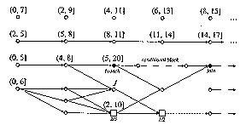
Example of task graphs

Slide 108
Task graph examples
The system shown in the sample task graph includes two periodic tasks.
The task whose jobs are represented by the vertices in the top row has a phase 0, period 2, and relative deadline 7. The jobs in it are independent since there are no edges to or from these jobs.
In other words, the jobs released in later periods are ready for execution as soon as they are released, even though some job released earlier is not yet complete.
This is common with periodic tasks.

Slide 109
Task graph examples (2)
The vertices in the second row represent jobs in a periodic task with phase 2,
period 3, and relative deadline 3.
The jobs in it are dependent.
The first job is the immediate predecessor of the second job, the second job is the immediate predecessor of the third job, etc.
The precedence graph of the jobs in this task is a chain.
A subgraph’s being a chain indicates that for every pair of jobs J_{i} and J_{k} in the subgraph, either J_{i} < J_{k} or J_{k} < J_{i}
Hence the jobs must be executed in serial order.

Slide 110
Other kinds of task graphs
A task graph like the example is only really necessary when the system contains components which have complex dependencies like the subgraph below the periodic tasks.
Many types of interactions and communication among jobs are not captured by a precedence graph but can be captured by a task graph.
Unlike a precedence graph, a task graph can contain difference types of edges representing different types of dependencies.

Slide 111
Data Dependency
Data dependency cannot be captured by a precedence graph.
In many real-time systems jobs communicate via shared data.
Often the designer chooses not to synchronize producer and consumer jobs. Instead the producer places the data in a shared address space to be used by the consumer at any time.
In this case the precedence graph will show the producer and consumer jobs as independent since they are apparently not constrained to run in turn.

Slide 112
Data dependency 2
In a task graph, data dependencies are represented explicitly by data dependency edges among jobs.
There is a data dependency edge from the vertex J_{i} to vertex J_{k} in the task graph if the job J_{k} consumes data generated by J_{i} or the job J_{i} sends messages to J_{k}
A parameter of an edge from J_{i} to J_{k} is the volume of data from J_{i} to J_{k}.
In multiple processor systems the volume of data to be transferred can be used to make decisions about scheduling of jobs on processors.

Slide 113
Data dependency 3
Sometimes the scheduler may not be able to schedule data dependent jobs independently.
To ensure data integrity some locking mechanism must be used to ensure that only one job can access the shared data at a time.
This leads to resource contention, which may also constrain the way jobs execute.
However this constraint is imposed by scheduling and resource control algorithms.
It is not a precedence constraint because it is not an intrinsic constraint on the execution order of jobs.

Slide 114
Functional parameters
While scheduling and resource control decisions are made independently of most functional characteristics of jobs, there are several functional properties that do affect these decisions.
The workload model must explicitly describe these properties using functional parameters:
  Preemptivity
  Criticality
  Optional interval
  Laxity type

Slide 115
Preemptivity of Jobs
Execution of jobs can often be interleaved. The scheduler may suspend the execution of a less urgent job and give the processor to a more urgent job. Later, the less urgent job can resume its execution.
This interruption of job execution is called preemption.
A job is preemptable if its execution can be suspended at any time to allow the execution of other jobs and can later be resumed from the point of suspension.

Slide 116
Preemptivity of Jobs 2
A job is non-preemptable if it must be executed from start to completion without interruption.
This constraint may be imposed because its execution, if suspended, must be executed again from the beginning.
Sometimes a job may be preemptable everywhere except for a small portion which is constrained to be non-preemptable.
An example is an interrupt handling job. An interrupt handling job usually begins by saving the state of the processor. This small portion of the job is non-preemptable since suspending the execution may cause serious errors in the data structures shared by the jobs.

Slide 117
Preemptivity of Jobs 3
During preemption the system must first save the state of the preempted job at the time of preemption so that it can resume the job from that state.
Then the system must prepare the execution environment for the preempting job before starting the job.
e.g. in the case of CPU jobs, the state of the preempted job includes the contents of the CPU registers. After saving the contents of the registers in memory and before the preempting job can start, the operating system must load the new register values, clear pipelines, perhaps clear the caches, etc.
These actions are called a context switch.

Slide 118
Preemptivity of Jobs 4
The amount of time required to accomplish a context switch is called a context-switch time.
The terms context switch and context-switch time are used to mean the overhead work done during preemption, and the time required to accomplish this work.
The fact that a job is non-preemptable is treated as a constraint of the job.
The non-preemptability of a job may be a consequence of a constraint on the usage of some resource.

Slide 119
Criticality of Jobs
In any system, jobs are not equally important.
The importance (or criticality) of a job is a positive number that indicates how critical a job is with respect to other jobs.
Some books use the terms priority and weight to refer to importance
  The more important a job, the higher its priority or the larger its weight
Because priority and weight can have other meanings, we will use the terms importance or criticality to measure criticality.

Slide 120
Criticality of Jobs 2
During an overload when it is not possible to schedule all the jobs to meet their deadlines, it may make sense to sacrifice the less critical jobs, so that the more critical jobs meet their deadlines.
For this reason, some scheduling algorithms try to optimize weighted performance measures, taking into account the importance of jobs.

Slide 121
Resource parameters of jobs and parameters of resources
Every job requires a processor throughout its execution.
A job may also require some resources.
The resource parameters of each job give us the type of processor and the units of each resource type required by the job and the time intervals during its execution when the resources are required.
These parameters are needed to support resource management decisions.

Slide 122
Preemptivity of resources
The resource parameters of jobs give us a partial view of the processors and resources from the perspective of the applications.
Sometimes we need to describe the characteristics of processors and resources independent of the application.
For this we use parameters of resources.
A resource parameter is preemptivity.
A resource is non-preemptable if each unit of the resource is constrained to be used serially.

Slide 123
Preemptivity of resources 2
Once a unit of a non-preemptable resource is allocated to a job, other jobs needing the unit must wait until the job completes its use.
If jobs can use every unit of a resource in an interleaved way, the resource is preemptable.
A lock on a data object is an example of a non-preemptable resource.
This does not mean that the job is non-preemptable on others resources or on the processor.
The transaction can be preempted on the processor by other transactions not waiting for the locks.

Slide 124
Resource Graph
A resource graph describes the configuration of resources.
There is a vertex R_{i} for every processor or resource R_{i} in the system.
We can treat resources and processors similarly for the sake of convenience.
The attributes of the vertex are the parameters of the resource.
The resource type of a resource tells us whether the resource is a processor or a passive resource, and its number gives us the number of available units.

Slide 125
Resource graph 2
Edges in resource graphs represent the relationship among resources.
Using different types of edges we can describe different configurations of the underlying system.

Slide 126
Resource graph 3
There are 2 types of edges in resource graphs
  An edge from vertex R_{i} to vertex R_{k} can mean that R_{k} is a component of R_{i}. e.g. a memory is part of a computer and so is a monitor.
  This edge is an is-a-part-of edge.
  The subgraph containing all the is-a-part-of edges is a forest. The root of each tree represents a major component, with subcomponents represented by vertices. e.g. the resource graph of a system containing 2 computers consists of 2 trees. The root of each tree represents a computer with children of this vertex including CPUs etc.

Slide 127
Resource graph 4
The other type of edge in resource graphs
  Some edges in resource graphs represent connectivity between components.
  These edges are called accessibility edges.
  e.g. if there is a connection between two CPUs in the two computers, then each CPU is accessible from the other computer and there is an accessibility edge from each computer to the CPU of the other computer.
  Each accessibility edge may have several parameters.
  e.g. a parameter of an accessibility edge from a processor P_{i} to another P_{k} is the cost of sending a unit of data from a job executing on P_{i} to a job executing on P_{k}
  Some algorithms use such information to decide how to allocate jobs and resources to processors in a statically configured system.

Slide 128
Scheduling hierarchy
The figure ‘model of a real-time system’ shows the three elements of our model of real-time systems.
The application system is represented by
  a task graph which gives the processor time and resource requirements of jobs, their timing constraints and dependencies
  A resource graph describing the resources available to execute the application system, their attributes and rules governing their use
  And between these graphs are the scheduling and resource access-control algorithms used by the operating system.

Slide 129
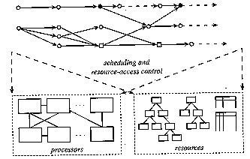
Model of a real-time system

Slide 130
Scheduler and schedules
Jobs are scheduled and allocated resources according to a chosen set of scheduling algorithms and resource access-control protocols.
The scheduler is a module that implements these algorithms.
The scheduler assigns processors to jobs, or equivalently, assigns jobs to processors.

Slide 131
Scheduler and schedules 2
A job is scheduled in a time interval on a processor if the processor is assigned to the job, and hence the job executes on the processor, in the time interval.
The total amount of processor time assigned to a job according to a schedule is the total length of all the time intervals during which the job is scheduled on some processor.
A schedule is an assignment by the scheduler of all the jobs in the system on the available processors.

Slide 132
Scheduler and schedules 3
A scheduler works correctly if it produces only valid schedules.
A valid schedule satisifies the following conditions:
  1. Every processor is assigned to at most one job at any time.
  2. Every job is assigned at most one processor at any time.
  3. No job is scheduled before its release time.
  4. Depending on the scheduling algorithms used, the total amount of processor time assigned to every job is equal to its maximum or actual execution time.
  5. All the precedence and resource usage constraints are satisfied.

Slide 133
Scheduler and schedules 4
Note that we have assumed implicitly that jobs do not run in parallel on more than one processor to speed up their execution.
Of course it may be possible to run parallel jobs but we will not be considering such a complication at this stage.

Slide 134
Feasibility
A valid schedule is a feasible schedule if every job completes by its deadline and in general meets its timing constraints.
A set of jobs is schedulable according to a scheduling algorithm if when using the algorithm the scheduler always produces a feasible schedule.

Slide 135
Optimality
The criterion we usually use to to measure the performance of scheduling algorithms is for hard real-time applications is their ability to find feasible schedules of the given application system whenever such schedules exist.
A hard real-time scheduling algorithm is optimal if using the algorithm the scheduler always produces a feasible schedule if the given set of jobs has feasible schedules.
If an optimal algorithm cannot find a feasible schedule, we can conclude that a given set of jobs cannot feasibly be scheduled by any algorithm.

Slide 136
Other scheduling performance measures
Apart from feasibility other commonly used performance measures include:
  Maximum and average tardiness
  Lateness
  Response time
  Miss, loss and invalid rates
The right choice of performance measure depends on the objective of scheduling.

Slide 137
Other scheduling performance measures 2
e.g. when a set of jobs is not schedulable by any algorithm, we may settle for a schedule according to which the number of jobs failing to complete in time is smallest.
Hence an algorithm performs better if it can produce a schedule with a smaller number of late jobs than others.
Alternatively we may be more concerned about tardiness, i.e. how late things can be, rather than how many jobs are late.

Slide 138
Other scheduling performance measures 3
The lateness of a job is the difference between its completion time and its deadline.
Unlike the tardiness of a job, which is never negative, lateness of a job which completes before its deadline is negative. Lateness is positive if the job completes after its deadline.
Sometimes we wish to keep jitters in completion times small. We can do this by using scheduling algorithms that try to minimize the average absolute lateness of jobs.

Slide 139
Other scheduling performance measures 4
When all jobs have the same release time and deadline, the problem of scheduling the jobs to meet their deadlines is the same as that of scheduling to minimize the completion time of the job which completes last.
The response time of that job is the response time of the set of jobs as a whole, and is often called the makespan of the schedule.

Slide 140
Other scheduling performance measures 5
The makespan is a performance criterion commonly used to compare scheduling algorithms.
An algorithm that produces a schedule with a shorter makespan is better.
If the makespan is less than or equal to the length of their feasible interval, the jobs can meet their deadline.

Slide 141
Other scheduling performance measures 6
The most frequently used performance measure for jobs with soft deadlines is their average response time.
We can compare the performance of scheduling algorithms on a given set of jobs based on the average response times of the jobs when scheduled according to the algorithms.
The smaller the average response time, the better the algorithm.

Slide 142
Other scheduling performance measures 7
In a system with a mixture of jobs with hard and soft deadlines, the objective of scheduling is typically to minimize the response time of jobs with soft deadlines while ensuring that all jobs with hard deadlines complete in time.
Since there is no advantage in completing jobs with hard deadlines early, we may delay their execution in order to improve the response time of jobs with soft deadlines.

Slide 143
Other scheduling performance measures 8
For many soft real-time applications it is acceptable to complete some jobs late or to discard late jobs.
For such applications suitable performance measures includes the miss rate and loss rate.
Miss rate gives the percentage of jobs that are executed but complete late.
Loss rate gives the percentage of jobs that are not executed at all.

Slide 144
Other scheduling performance measures 9
When it is impossible to complete all jobs on time, a scheduler may choose to discard some jobs.
By discarding some jobs the scheduler increases the loss rate but completes more jobs in time. Thus it reduces the miss rate.
Similarly, reducing the loss rate may lead to an increase in miss rate.
Thus when we talk about minimizing the miss rate, we mean that the miss rate is reduced as much as possible subject to keeping the loss rate below some acceptable threshold.

Slide 145
Other scheduling performance measures 10
Alternatively we may want to minimize the loss rate provided the miss rate is below some threshold.
A performance measure that captures this trade-off is the invalid rate.
The invalid rate is the sum of the miss and loss rates, and gives the percentage of jobs that do not produce a useful result.
We try to minimize the invalid rate.

Slide 146
Interaction among Schedulers
So far we have considered scheduling the application system on the underlying resources and processors.
Typically a system has a hierarchy of schedulers.
Some processors and resources used by the application system are not physical entities, rather they are logical resources.
Logical resources must be scheduled on physical resources.
The algorithms used for this scheduling are different from those used to schedule the application system using the resource.

Slide 147
Interaction among Schedulers 2
A job may model a server that executes on behalf of its client jobs.
The time and resources allocated to the server job must in turn be allocated to its client jobs.
Again the algorithm used by the server to schedule its clients may be different from the algorithm used by the operating system to schedule the server with other servers.

Slide 148
Interaction among Schedulers 3
Consider as an example database locks as resources.
In fact these resources are implemented by a database management system whose execution is scheduled on one or more processors.
The scheduler that schedules the database management system may be different from the scheduler that schedules the application system using the locks, and may use different algorithms.
Thus we have two levels of scheduling.
  In the higher level the application system is scheduled on the resources.
  In the lower level, the jobs implementing the resources are scheduled on the processors and resources needed by them.

Slide 149
Interaction among Schedulers 4
Consider another example of an application system containing periodic tasks and aperiodic jobs on one processor.
All the aperiodic jobs are placed in a queue when they are released.
There is a poller.
Together with the periodic tasks, the poller is scheduled to execute periodically.
When the poller executes, it checks the aperiodic job queue.
If there are aperiodic jobs waiting, it chooses an aperiodic job from the queue and executes the job. Hence the aperiodic jobs are clients of the poller.
We again have two levels of scheduling
  In the lower level, the scheduler provided by the operating system schedules the poller and other periodic tasks
  In the higher level the poller schedules its clients.

Slide 150
Interaction among Schedulers 5
In every level of the scheduling hierarchy we can represent the workload by a task graph and the processors and resources required by it with a resource graph.
Thus every level in the scheduling hierarchy can be represented in a uniform way.

Slide 151
Commonly Used Approaches to Real-Time Scheduling
We will examine three commonly used approaches to real-time scheduling
  Clock-driven
  Weighted round-robin
  Priority-driven
The weighted round-robin approach is mainly used for scheduling real-time traffic in high-speed switched networks. It is not ideal for scheduling jobs on CPUs.

Slide 152
Clock-Driven Approach
Clock-driven scheduling is often called time-driven scheduling.
When scheduling is clock-driven, decisions are made at specific time instants on what jobs should execute when.
Typically in a system using clock-driven scheduling, all the parameters of hard real-time jobs are fixed and known.
A schedule of the jobs is computed off-line and is stored for use at run-time.
The scheduler schedules the jobs according to this schedule at each scheduling decision time.
Thus scheduling overhead at run-time is minimized.

Slide 153
Clock-driven approach 2
Scheduling decisions are usually made at regularly spaced time instants.
One way to implement this is to use a hardware timer set to expire periodically which causes an interrupt which invokes the scheduler.
When the system is initialized, the scheduler selects and schedules the jobs that will execute until the next scheduling decision time and then blocks itself waiting for the expiration of the timer.
When the timer expires, the scheduler repeats these actions.

Slide 154
Round-robin approach
The round-robin approach is commonly used for scheduling time-shared applications.
When jobs are scheduled in a round-robin system, every job joins a first-in-first-out (FIFO) queue when it becomes ready for execution.
The job at the head of the queue executes for at most one time slice.
If the job does not complete by the end of the time slice, it is preempted and placed at the end of the queue to wait for its next turn.
When there are n ready jobs in the queue, each job gets one time slice in n, that is every round.

Slide 155
Round-robin approach 2
Because the length of the time slice is relatively short (typically tens of milliseconds) the execution of each jobs begins almost immediately after it becomes ready.
In essence, each job gets 1/nth share of the processor when there are n jobs ready for execution.
This is why the round-robin algorithm is also known as the processor-sharing algorithm.

Slide 156
Weighted round-robin approach
The weighted round-robin algorithm has been used for scheduling real-time traffic in high-speed switched networks.
Rather than giving all the ready jobs equal shares of the processor, different jobs may be given different weights.
The weights refer to the fraction of the processor time allocated to the job.
A job with weight wt gets wt time slices every round.
The length of the round equals the sum of the weights of all the ready jobs.
By adjusting the weights of jobs we can speed up or slow down the progress of each job.

Slide 157
Weighted round-robin approach 2
By giving each job a fraction of the processor, a round-robin scheduler delays the completion of every job.
If round-robin scheduling is used to schedule precedence constrained jobs, the response time of a chain of jobs can get very large.
For this reason, the weighted round-robin approach is unsuitable for scheduling such jobs.
However if a successor job is able to consume incrementally what is produced by a predecessor job, such as with a Unix pipe, weighted round-robin scheduling may be a reasonable approach.

Slide 158
Weighted round-robin approach 3
For example consider two sets of jobs
J₁ = {J_{1,} ₁, J_{1 ,} ₂} and J₂ = {J_{2,} ₁, J_{2 ,} ₂}
The release times of all jobs are 0
The execution times of all jobs are 1
J_{1,} ₁ and J_{2,} ₁ execute on processor P₁
J_{1,} ₂ and J_{2,} ₂ execute on processor P₂
Suppose that J_{1,} ₁ is the predecessor of J_{1,} ₂
Suppose that J_{2,} ₁ is the predecessor of J_{2,} ₂

Slide 159
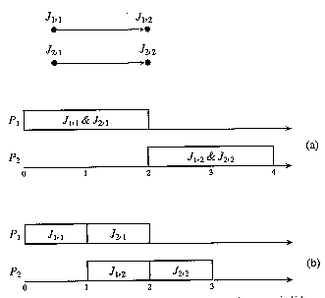
Round-Robin Scheduling

Slide 160
Weighted round-robin approach 4
We can see in the figure ‘round-robin scheduling’ that both sets of jobs complete approximately at time 4 if the jobs are scheduled in a weighted round-robin manner.
In contrast, we can see that if the jobs on each processor are scheduled one after the other, one of the chains can complete at time 2 and the other at time 3.
Suppose that the result of the first job in each set is piped to the second job in the set. The latter can execute after each one or a few time slices of the former complete.
Then it is better to schedule the jobs on a round-robin basis, because both sets can complete a few time slices after time 2.

Slide 161
Weighted round-robin approach 5
In a switched network a downstream switch can begin to transmit an earlier portion of the message as soon as it receives the portion.
It does not have to wait for the arrival of the rest of the message.
The weighted round-robin approach does not require a sorted priority queue, only a round-robin queue.
This is a distinct advantage for scheduling message transmissions in ultrahigh-speed networks since fast priority queues are very expensive.

Slide 162
Priority-driven approach
The term priority-driven algorithms refers to a class of scheduling algorithms that never leave any resource idle intentionally.
With a priority-driven algorithm a resource idles only when no job requiring the resource is ready for execution.
Scheduling decisions are made when events such as releases and completions of jobs occur.
Priority-driven algorithms are event-driven.
Other commonly used terms for this approach are greedy scheduling, list scheduling, and work-conserving scheduling.

Slide 163
Priority-driven approach 2
A priority-driven algorithm is greedy because it tries to make locally optimal decisions.
Leaving a resource idle while some job is ready to use the resource is not locally optimal.
When a processor or resource is available and some job can use it to make progress, a priority-driven algorithm never makes the job wait.
However there are cases where it is better to have some jobs wait even when they are ready to execute and the resources they require are available.

Slide 164
Priority-driven approach 3
The term list scheduling is also used because any priority-driven algorithm can be implemented by assigning priorities to jobs.
Jobs ready for execution are placed in one or more queues ordered by the priorities of the jobs.
At any scheduling decision time, the jobs with the highest priorities are scheduled and executed on the available processors.
Hence a priority-driven scheduling algorithm is defined largely by the list of priorities it assigns to jobs.
The priority list and other rules such as whether preemption is allowed, define the scheduling algorithm completely.

Slide 165
Priority-driven approach 4
Most non real-time scheduling algorithms are priority-driven.
Examples include:
  FIFO (first-in-first-out) and LIFO (last-in-first-out) algorithms which assign priorities to jobs based on their release times.
  SETF (shortest-execution-time-first) and LETF (longest-execution-time-first) algorithms which assign priorities based on job execution times.
Because we can dynamically change the priorities of jobs, even round-robin scheduling can be thought of as priority-driven.
The priority of the executing job is lowered to the minimum among all jobs waiting for execution after the job has executed for a time slice.

Slide 166
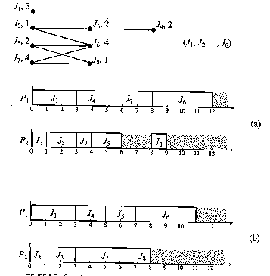
Priority-driven approach 5
The figure “examples of priority driven scheduling”

Slide 167
Priority-driven approach 6
In the figure “examples of priority driven scheduling”
The task graph is a precedence graph with all edges showing precedence constraints.
The number next to the name of each job is its execution time.
J₅ is released at time 4.
All the other jobs are released at time 0.
We want to schedule and execute the jobs on two processors P₁ and P₂.
They communicate via a shared memory hence communication costs are negligible.
The schedulers of the processors share a common priority queue of ready jobs.

Slide 168
Priority-driven approach 7
The priority list is given next to the graph.
J_{i} has a higher priority than J_{k} if i < k.
All the jobs are preemptable
Scheduling decisions are made whenever some job becomes ready for execution or some job completes.
The first schedule (a) shows the schedule of jobs on the two processors generated by the priority-driven algorithm following this priority assignment.
At time 0, jobs J₁, J₂, and J₇ are ready for execution.
They are the only jobs in the priority queue at this time.
Since J₁ and J₂ have higher priorities than J₇ they are ahead of J₇ in the queue and hence are scheduled.

Slide 169
Priority-driven approach 8
At time 1, J₂ completes and hence J₃ becomes ready. J₃ is placed in the priority queue ahead of J₇ and is scheduled on P₂, the processor freed by J₂.
At time 3, both J₁ and J₃ complete. J₅ is still not released. J₄ and J₇ are scheduled.
At time 4, J₅ is released. Now there are three ready jobs. J₇ has the lowest priority among them so it is preempted and J₄ and J₅ have the processors.
At time 5, J₄ completes. J₇ resumes on processor P₁.
At time 6, J₅ completes. Because J₇ is not yet completed, both J₆ and J₈ are not yet ready for execution. Thus processor P₂ becomes idle.
J₇ finally completes at time 8. J₆ and J₈ can now be scheduled on the processors.

Slide 170
Priority-driven approach 9
The lower schedule (b) shows a non-preemptive schedule according to the same priority assignment.
Before time 4 this schedule is the same as before.
However at time 4 when J₅ is released, both processors are busy. J₅ has to wait until J₄ completes at time 5 before it can begin execution.
It turns out that for this system, postponement of the higher priority job benefits the set of jobs as a whole.
The entire set completes one time unit earlier according to the non-preemptive schedule.

Slide 171
Priority-driven approach 10
In general however, non-preemptive scheduling is not better than preemptive scheduling.
The question is when is preemptive scheduling better than non-preemptive scheduling and vice versa?
There is no known answer to this question in general.
In the special case where jobs have the same release time, preemptive scheduling is better, when the cost of preemption is ignored.
Specifically, in a multiprocessor system, the minimum makespan (i.e. the response time of the job that completes last among all the jobs) achievable by an optimal preemptive algorithm is shorter than the makespan achievable by an optimal nonpreemptive algorithm.

Slide 172
Priority-driven approach 11
The question here is whether the difference in the minimum makespans achievable by the tow classes of algorithms is significant.
In particular is the theoretical gain in makespan achievable by preemption enough to compensate for the context switch overhead of preemption?
The answer to this question is only known for the two processor case, where it has been shown that the minimum makespan achievable by non-preemptive algorithms is never more than 4/3 times the minimum makespan achievable by preemptive algorithms when the cost of preemption is negligible.

Slide 173
Dynamic versus Static Systems
We have seen examples of jobs that are ready for execution being placed in a priority queue common to all processors.
When a processor is available, the job at the head of the queue executes on the processor.
Such a system is called a dynamic system, because jobs are dynamically dispatched to processors.
In the example of priority scheduling we allowed each preempted job to resume on any processor.
We say a job migrates if it starts execution on a processor, is preempted, and later resumes on a different processor.

Slide 174
Dynamic versus Static Systems 2
An alternate approach to scheduling in multiprocessor and distributed systems is to partition the jobs in the system into subsystems and to allocate the subsystems statically to particular processors.
In such systems, jobs are moved between processors only when the system must be reconfigured such as when a processor fails.
We call such systems, static systems, because the system is statically configured.
If jobs on different processors are dependent the schedulers on the processors must synchronize the jobs according to some synchronization and resource access-control protocol.
Otherwise, jobs on each processor are scheduled by themselves

Slide 175
Dynamic versus Static Systems 3
For example we could do a static partitioning of the jobs in our priority-driven scheduling example.
Put J₁, J₂, J₃, J₄ on P₁ and the remaining jobs on P₂.
The priority list is segmented into two parts:
  (J₁, J₂, J₃, J₄) used by the scheduler of processor P₁
  (J₅, J₆, J₇, J₈) used by the scheduler of processor P₂
It is easy to see that the jobs on P₁ complete by time 8 and the jobs on P₂ complete by time 11.
Also J₂ completes by time 4 while J₆ starts at time 6, thus the precedence constraint is satisfied.

Slide 176
Dynamic versus Static Systems 4
In this example the response of the static system is just as good as that of the dynamic system.
In general we may expect that we can get better average response by dynamically dispatching and executing jobs.
While dynamic systems may be more responsive on average, their worst case real-time performance may be poorer than static systems.
More importantly, there exist no reliable techniques for validating the timing characteristics of dynamic systems, whereas such techniques exist for static systems.
For this reason, most hard real-time systems implemented today are static.

Slide 177
Effective release times and deadlines
The given release times and deadlines are sometimes inconsistent with the precedence constraints of the jobs.
  i.e. the release time of a job may be later than that of its successors, and its deadline may be earlier than that of its predecessors.
Rather than working with the given release times and deadlines, we first derive a set of effective release times and deadlines from these timing constraints together with the given precedence constraints.
These derived timing constraints are consistent with the precedence constraints.

Slide 178
Effective release times and deadlines 2
Where there is only one processor we can compute the derived values:
  Effective Release Time:
    The effective release time of a job without predecessors is equal to its given release time.
    The effective release time of a job with predecessors is equal to the maximum value among its given release time and the effective release times of all its predecessors.
  Effective Deadline:
    The effective deadline of a job without a successor is equal to its given deadline.
    The effective deadline of a job with successors is equal to the minimum value among its given deadline and the effective deadlines of all of its successors.
The effective release times of all the jobs can be computed in one pass through the precedence graph in O(n²) time where n is the number of jobs. Similarly for the effective deadlines.

Slide 179

Effective release times and deadlines 3
Consider the following example whose task graph is given in the following figure “example of effective timing constraints”

Slide 180
Effective release times and deadlines 4
Consider the following example whose task graph is given in figure “example of effective timing constraints”
The numbers in brackets next to each job are its given release time and deadline.
Because J₁ and J₂ have no predecessors, their effective release times are their given release times, 2 and 0 respectively.
The given release time of J₃ is 1, but the latest effective release time of its predecessors is 2 (that of J₁) so its effective release time is 2.
The effective release times of J₄, J₅, J₆, J₇ are 4, 2, 4, 6 respectively.

Slide 181
Effective release times and deadlines 5
Consider the following example whose task graph is given in figure “example of effective timing constraints”
J₆ and J₇ have no successors so their effective deadlines are their given deadlines, 20 and 21 respectively.
Since the effective deadlines of the successors of J₄ and J₅ are later than the given deadlines of J₄ and J₅, the effective deadlines of J₄ and J₅ are equal to their given deadlines, 9 and 8 respectively.
However the given deadline of J₃ (12) is larger than the minimum value (8) of its successors, so the effective deadline of J₃ is 8.
Similarly the effective deadlines of J₁ and J₂ are 8 and 7 respectively.

Slide 182
Effective release times and deadlines 6
Note that we have ignored the execution times of jobs in working out our effective release times and deadlines.
So to be accurate the effective deadline of a job should be as early as the deadline of each of its successors minus the execution time of the successor.
The effective release time of the job should be that of its predecessor plus the execution time of the predecessor.
Interestingly, when there is only one processor, it has been shown that it is feasible to schedule a set of jobs on a processor according to their given release times and deadlines if and only if it is feasible to schedule the set according to their effective release times and deadlines defined above.

Slide 183
Effective release times and deadlines 7
When there is only one processor and the jobs are preemptable, working with the effective release times and deadlines allows us to temporarily ignore the precedence constraints and treat all the jobs as if they are independent.
Of course that means that we could produce an invalid schedule that does not meet some precedence constraint.
In our last example, J₁ and J₃ have the same effective release time and deadline. An algorithm that ignores the precedence constraint between them may schedule J₃ before J₁ .
If that happens, we can always add a step to swap the two jobs, and make the schedule a valid one.

Slide 184
Earliest-Deadline-First (EDF) Algorithm
A way to assign priorities to jobs is on the basis of their deadlines.
Earliest-Deadline-First (EDF) algorithm is based on the priority assignment whereby the earlier the deadline, the higher the priority.
This algorithm is important because it is optimal when used to schedule jobs on a processor when preemption is allowed and there is no contention for resources.

Slide 185
Earliest-Deadline-First (EDF) Algorithm (2)
When preemption is allowed and jobs do not contend for resources, the EDF algorithm can produce a feasible schedule of a set of jobs J with arbitrary release times and deadlines on a processor, if and only if J has feasible schedules.
Any feasible schedule of J can be systematically transformed into an EDF schedule.
To see how we can look at the figure “Transformation of a non-EDF schedule into an EDF schedule”
Suppose that in a schedule parts of J_{i} and J_{k} are scheduled in intervals I₁ and I₂ respectively, and that deadline d_{i} of J_{i} is later than deadline d_{k} of J_{k}, but I₁ is earlier than I₂.

Slide 186
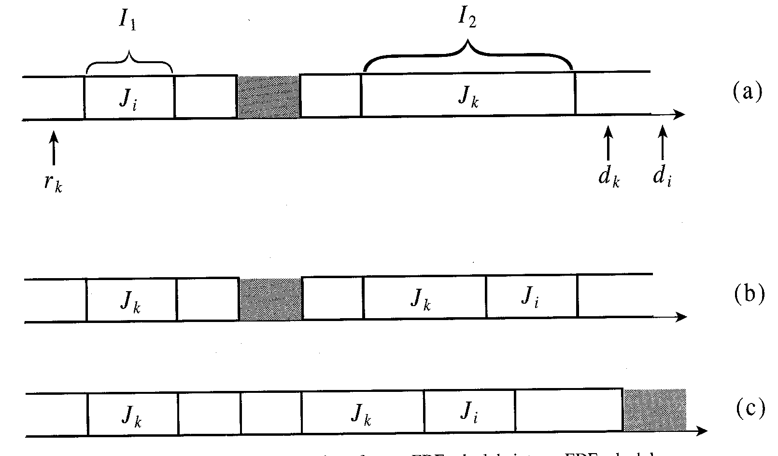
Earliest-Deadline-First (EDF) Algorithm (3)
figure “Transformation of a non-EDF schedule into an EDF schedule”

Slide 187
Earliest-Deadline-First (EDF) Algorithm (4)
There are two cases:
  First case
    The release time of J_{k} may be later than the end of I₁.
    J_{k} cannot be scheduled in I₁.
    The 2 jobs are already scheduled according to EDF.
  Second case
    The release time r_{k} of J_{k} is before the end of I₁.
    Without loss of generality we can assume that r_{k} is no later than the beginning of I₁.
To transform the given schedule we swap J_{i} and J_{k}.
If I₁ is shorter than I₂, we move the portion of J_{k} that fits in I₁ forward to I₁ and move the entire portion of J_{i} scheduled in I₁ backward to I₂ and place it after J_{k}.

Slide 188
Earliest-Deadline-First (EDF) Algorithm (5)
Clearly, this swap is always possible.
We can do a similar swap if I₁ is longer than I₂.
In which case we move the entire portion of J_{k} scheduled in I₂ to I₁ and place it before J_{i} and move the portion of J_{i} that fits in I₂ to the interval.
The result of this swap is that these two jobs are now scheduled according to EDF.
We repeat this transformation for every pair of jobs not scheduled according to EDF until no such pair exists.

Slide 189
Earliest-Deadline-First (EDF) Algorithm (6)
The schedule so obtained may still not be an EDF schedule if some interval is left idle while there are jobs ready for execution but scheduled later.
This is illustrated in part (b) of the figure.
We can eliminate such an idle interval by moving one or more of these jobs forward into the idle interval and leave the interval where the jobs were scheduled idle.
Clearly this is always possible.
We repeat this until the processor never idles when there are jobs ready for execution.
This is illustrated in part (c) of the figure.

Slide 190
Earliest-Deadline-First (EDF) Algorithm (7)
This only works when there is preemption.
This is because the preemptive EDF algorithm can always produce a feasible schedule if such a schedule exists.
When the goal is to meet deadlines then there is no advantage in completing any job sooner than necessary.
We may even want to postpone the execution of hard real-time jobs to enable soft real-time jobs whose response times are important to complete earlier.
For this reason we sometimes use the Latest-Release-Time (LRT) algorithm (or reverse EDF algorithm).

Slide 191
Latest-Release-Time (LRT) Algorithm
The Latest-Release-Time algorithm treats release times as deadlines and deadlines as release times and schedules jobs backwards, starting from the latest deadline of all jobs, in a priority-driven manner, to the current time.
The ‘priorities’ are based on the later the release time, the higher the ‘priority’.
Because it may leave the processor idle when there are jobs awaiting execution, the LRT algorithm is not a priority-driven algorithm.

Slide 192
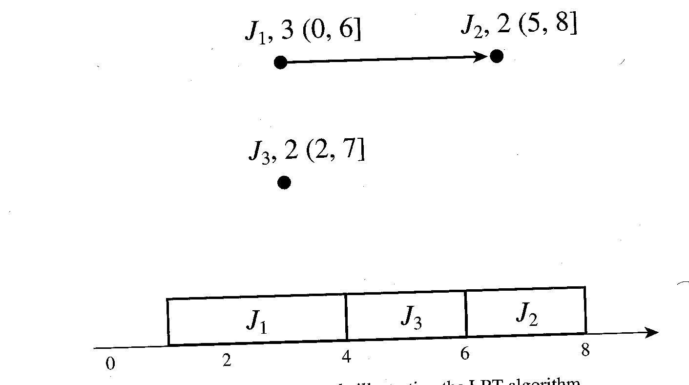
LRT Algorithm Example
In the following example, the number next to the job is the execution time and the feasible interval follows it.
The latest deadline is 8, so time starts at 8 and goes back to 0. At time 8, J2 is “ready” and is scheduled. At time 7, J3 is also “ready” but because J2 has a later release time, it has a higher priority, so J2 is scheduled from 7 to 6.
When J2 “completes” at time 6, J1 is “ready” however J3 has a higher priority so is scheduled from 6 to 4.
Finally J1 is scheduled from 4 to 1.

Slide 193
Least-Slack-Time-First (LST) Algorithm
Another algorithm optimal for scheduling preemptive jobs on one processor is
Least-Slack-Time-First (LST) also called Minimum-Laxity-First (MLF).
At any time t, the slack (or laxity) of a job with deadline d, is equal to d - t minus the time required to complete the remainder of the job.

Slide 194
Least-Slack-Time-First (LST) Algorithm 2
Job J₁ from the LRT example is released at time 0 and has its deadline at time 6 and execution time 3.
Hence its slack is 3 at time 0.
The job starts to execute at time 0.
As long as it executes its slack remains 3 because at any time before its completion its slack is 6 - t - (3 - t)

Slide 195
Least-Slack-Time-First (LST) Algorithm 3
Suppose J₁ is preempted at time 2 by J₃ which executes from time 2 to 4.
During this interval the slack of J₁ decreases from 3 to 1.
At time 4 the remaining execution time of J₁ is 1, so its slack is 6 - 4 - 1 = 1.
The LST algorithm assigns priorities to jobs based on their slacks.
The smaller the slack, the higher the priority

Slide 196
Non-optimality of EDF and LST
Do EDF and LST algorithms remain optimal if preemption is not allowed or there is more thhan one processor?
No! Consider the following 3 independent non-preemptable jobs, J₁, J₂, J₃, with release times 0, 2, 4 and execution times 3, 6, 4, and deadlines 10, 14, 12 respectively.

Slide 197
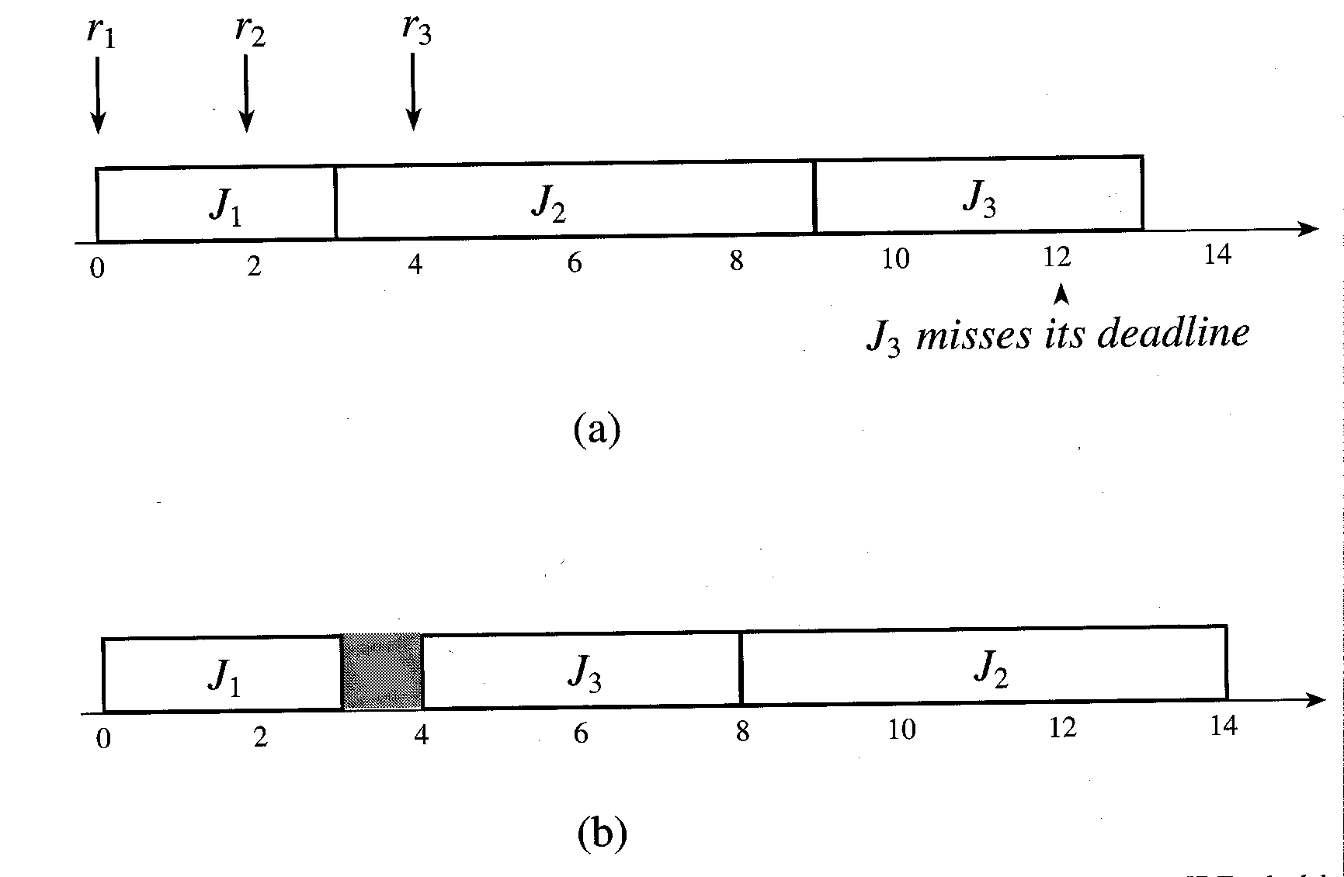
Nonoptimality of EDF and LST 2
Both EDF and LST would produce the infeasible schedule (a) whereas a feasible schedule is possible (b).
Note that (b) cannot be produced by a priority driven algorithm

Slide 198
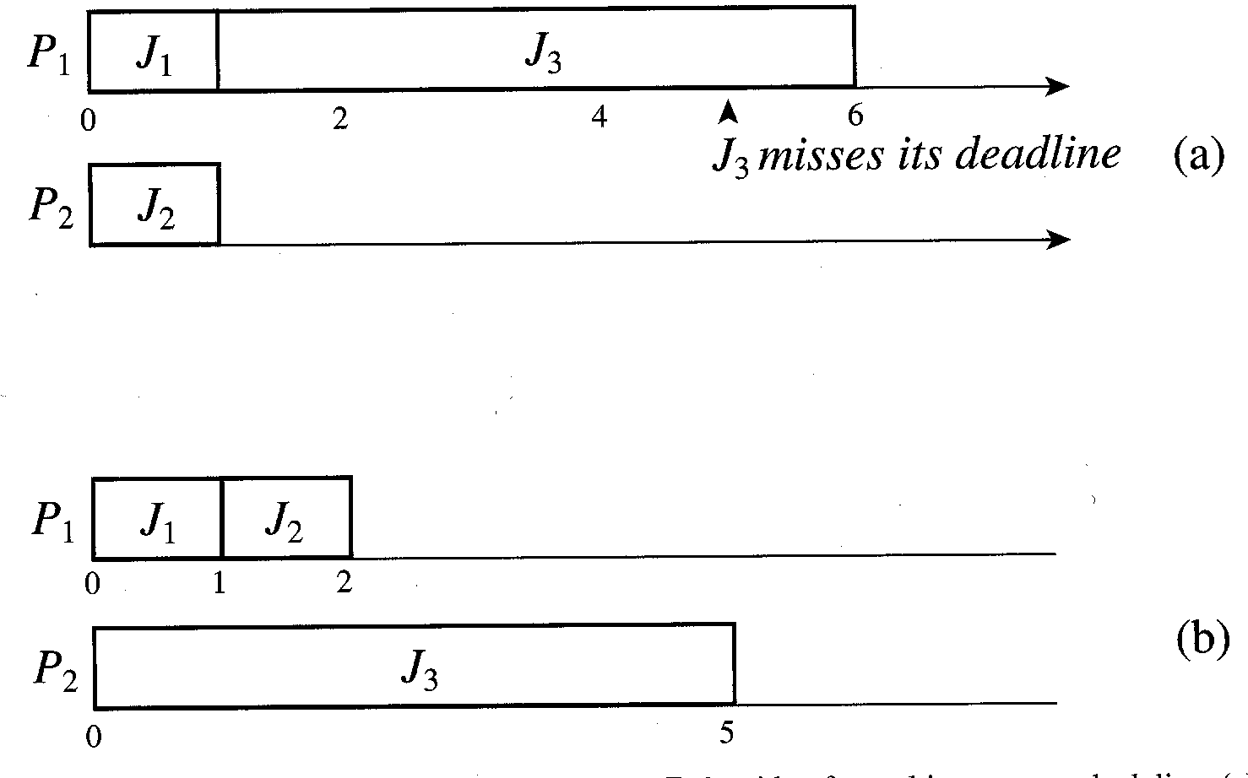
Non-optimality of EDF for multiprocessors
This time we have two processors and three jobs J₁, J₂, J₃, with execution times 1, 1, 5 and deadlines 1, 2, 5 respectively. All with release time 0.
EDF gives the infeasible schedule (a) whereas LST gives a feasible schedule (b) but in general LST is also non-optimal for multiprocessors.

Slide 199
Validating Timing Constraints in Priority-Driven Systems
Compared with the clock-driven approach, the priority-driven scheduling approach has many advantages:
  Easy to implement
  Often have simple priority assignment rules
  If the priority assignment rules are simple, the run-time overheads of maintaining priority queues can be small
  Does not require information about deadlines and release times in advance so it is suited to applications with varying time and resource requirements
On the other hand a clock-driven scheduler:
  Requires information about release times and deadlines of jobs in advance in order to schedule them

Slide 200
Validating Timing Constraints in Priority-Driven Systems (2)
Despite its merits, the priority-driven approach has not been widely used in hard real-time systems, especially safety-critical systems, until recently.
The main reason for this is that the timing behaviour of a priority-driven system is not deterministic when job parameters vary.
Thus it is difficult to validate that the deadlines of all jobs scheduled in a priority-driven manner indeed meet their deadlines when job parameters vary.

Slide 201
Validating Timing Constraints in Priority-Driven Systems (3)
In general, the validation problem can be stated:
  Given a set of jobs, the set of resources available to the jobs, and the scheduling (and resource access-control) algorithm to allocate processors and resources to jobs, determine whether all the jobs meet their deadlines.
This is a very difficult problem to solve when you don’t have all the information about all the jobs available in advance and can verify the complete schedule as in a clock-driven system.

Slide 202
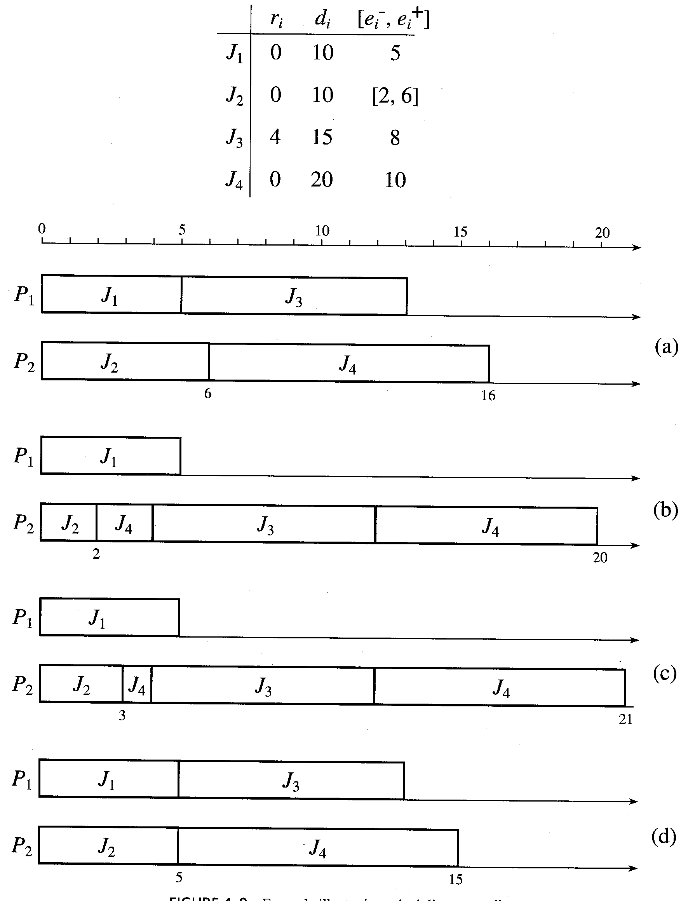
Anomalous Behaviour of Priority-Driven Systems
Consider the example in figure “illustrating scheduling anomalies”

Slide 203
Anomalous Behaviour of Priority-Driven Systems (2)
This example illustrates why the validation problem is difficult with priority-driven scheduling and varying job parameters.
Consider a simple system of four independent jobs scheduled on two processors in a priority-driven manner.
There is a common priority queue and the priority order of jobs is J₁, J₂, J₃, J₄, with J₁ being of highest priority.
It is a dynamic system.
Jobs may be preempted but never migrated to another processor. (a common characteristic)
The release times, deadlines and execution times or the jobs are provided in the table.

Slide 204
Anomalous Behaviour of Priority-Driven Systems (3)
The execution times of the jobs are fixed except for J₂ whose execution time is somewhere in the range [2,6]
Suppose we want to determine whether the system meets all the deadlines and whether the completion-time jitter of every job (i.e. the difference between the latest and earliest completion times of the job) is <= 4.
Let us simulate the possible schedules to see what can happen.
Suppose we schedule the jobs according to their priorities and try out J₂ with its maximum execution time 6 and also with its minimum execution time 2. (see the figure (a),(b))
It seems OK for deadlines and for completion-time jitter.

Slide 205
Anomalous Behaviour of Priority-Driven Systems (4)
Wrong! Have a look at cases (c) and (d)
As far as J₄ is concerned, the worst-case schedule is (c) when execution time of J₂ is 3 and J₄ completes at 21 missing the deadline.
The best-case schedule for J₄ is (d) when J₂ has execution time 5 and J₄ completes at time 15, however the completion time jitter exceeds its limit of 4.
To find the worst-case and best-case schedules we have to try all possible values of e2.
This is known as a scheduling anomaly, an unexpected timing behaviour of priority-driven systems.

Slide 206
Anomalous Behaviour of Priority-Driven Systems (5)
It has even been shown that the completion time of a set of non-preemptive jobs with identical release times can be later when more processors are used, and when they have shorter execution times and fewer dependencies.
It can even happen with a single processor and when jobs are preemptable when jobs have arbitrary release times and share resources.
Scheduling anomalies make validating a priority-driven system difficult whenever job parameters vary. Unfortunately variations in execution times and release times are often unavoidable, making priority-driven systems problematic in all but very small systems.

Slide 207
Priority-Driven Systems and Priority Inversion
Note that in our example of anomalous behaviour, it is possible to obtain valid schedules. It is just that our priority-driven algorithms could not do it.
For instance, if one assumed that J4 was not preemptable, then case © would meet its deadline, but you would be violating the rule that says that the highest priority runnable job should be run.
In this case J4 would continue running even though the higher priority J3 was able to run.
This is called a priority-inversion.
This happens when a lower priority job runs in preference to a higher priority job which has to wait.

Slide 208
Enough material for 2001’s exam
While we have not managed to get through all the material promised (topics in blue have been omitted) we have done sufficient for the all important examination.
We have looked at
  what real-time systems are
  various classes of real-time systems
  how to model real-time systems
  Scheduling of real-time systems in various ways

Slide 209
What else is there?
There are many more scheduling techniques available.
Some of these have interesting and useful properties.
We have seen some basic schedulers and most importantly we have examined the possible problems that can occur.

Slide 210
What else is there? (2)
Apart from more sophisticated scheduling methods, the critical feature of real-time system design is in making every job meet its deadline.
To give us confidence in our scheduling we should try to validate the schedule to determine whether it will always succeed in meeting deadlines.
This is a very complex process which we have not had time to cover properly.

Slide 211
What else is there? (3)
When we have the scheduling and validation sorted out, we need to actually implement a real-time system.
One approach is to build a special-purpose scheduler into our real-time application.
Another approach is to use a commercial real-time operating system.
Given that one does not have full information about how the commercial system might operate, this approach is not generally used in safety critical systems.

Slide 212
What else is there? (4)
The biggest problem in real-time systems is variation in job parameters. This is what makes validation difficult if not impossible.
Variation in execution time is extremely difficult if not impossible to predict with modern superscalar, speculative execution processors. In such machines the worst case performance is many orders of magnitude worse than the best case, so if we assume the worst case to be safe, we end up wasting most of the processor.
So, one approach is to use a collection of cheap, simple processors, each dedicated to a job.

Slide 213
What else is there? (5)
With such a distributed system of simple microcontrollers, the scheduling is not an issue since you can take the approach of allocating a dedicated processor which is always ready to run the job.
It may not be the cheapest approach but it has other advantages in terms of fault tolerance since you might be able to tolerate a single processor failure by rescheduling onto one of the many other processors.
This kind of redundant collection of simple processors is commonly used in the safety critical aerospace domain.

Slide 214
Conclusion
I hope you have learned something from this subject, even if it is only that real-time systems are quite difficult to make work reliably and to analyse.
You should do the exercises for your lab assignment mark
Have a look at the sample examination questions which are indicative of what to expect in the real exam.
And of course come along and get the rest of the marks in the final exam.

